Slide 1
PrintNet T Triple Suite
  Core Features

Slide 2
Agenda
Jobs and Workflows
Layout
Objects
Proof
Printing
Production
Output

Slide 3

1. Jobs and Workflows

Slide 4

Jobs and Workflows
Single Program/Single File Concept
  Using Workflows to design production graphically
  Multiple Data Input, Data Processing, Impositioning modules
  Graphical design interface (Layout)
  Proof (“what you see is what you get”)‏
  Production interface
Notes:
Because of the graphical interface, navigating workflows in PrintNet T is simple and user-friendly.
Multiple Data Input, Data Processing, Layout, Impositioning, and Output modules – the workflow can be as simple or complex as you need.
Graphical design of a job is made easy with PrintNet T’s logical Layout interface.
Proof function allows you to continuously check how your final product will look – “what you see is what you get”.
Production interface gives you final control over your printed product.

Slide 5
2. Layout

Slide 6
Context Schema
Workflow
Data Input
&
Manipulation
Document
Design
(Layout)‏
Impositioning
Approval (Proof)‏
Spool Production
Notes:
Layout is part of the workflow process; it has its own module in the module tree.

Slide 7
Layout Interface
Resolution and color independent design
  Saves time when creating different outputs from the same Layout, because it is not necessary to change the Layout.
Vector EPS
300 dpi
FullColor - PDF
Barcodes
600 dpi Jpeg
240 dpi
Black and White - IPDS
TTF / PS Format
600 dpi
SpotColor - AFP
Text

Slide 8
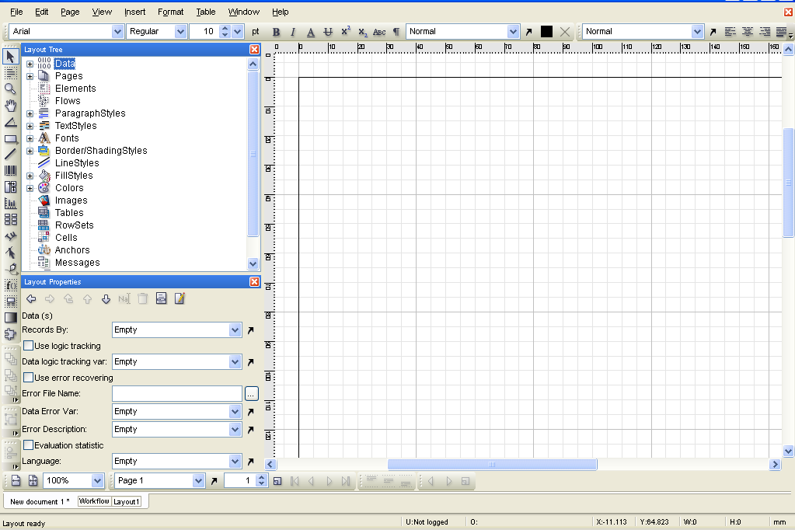
Layout Window
Menu and Format
Toolbars
Layout Tree and Layout Properties
Toolbar
Layout Area

Slide 9
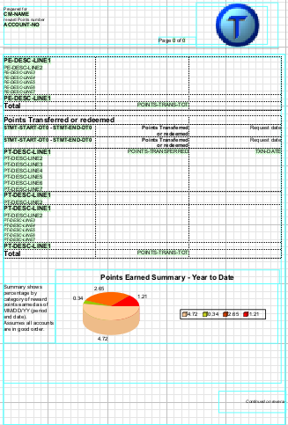
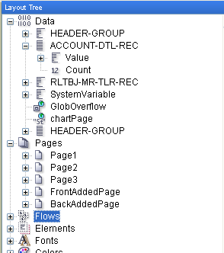
Layout Window
Graphical Layout Interface
  Layout Area – design page
  Quick and easy design creation
  Drag and Drop Objects into the layout.
  Logical Layout Part
  Layout Tree
    contains all used objects with settings and formats
  Quick and easy settings changes
    create complex layouts without scripting
Notes:
Graphical Layout Part
Objects can be created, deleted, grouped, and arranged with ease. Easy for users to see roughly what the job will look like on paper.
Logical Layout Part
All objects in Layout have nodes in the Layout Tree. By selecting a node in the Layout Tree, you can change the node’s properties directly and see the results in the graphical Layout window.

Slide 10
3. Objects

Slide 11
Objects
Object-oriented Layouts:
Generation of global formats called ‘styles’.
  Assignment of styles to generated objects.
  Changes or corrections can be done globally.
When a ‘style’ is changed in Layout Properties, all objects using that ‘style’ are changed automatically.

Slide 12
Objects – Settings Table
Objects
PrintNet T Settings
Text formatted
Background
Color
Border
Border/ShadingStyles
Text
Text formatted
TextStyles
Flow
Format
ParagraphStyles
Notes:
This table shows the different settings changes needed to create the formatted text box in the upper-left corner.
The peach background fill can be created in the color settings
The black line border can be created in Border/Shading Styles
The appearance of the text (“Text formatted”) can be set in TextStyles, or directly to the flow itself
The center justification can be set in ParagraphStyles

Slide 13
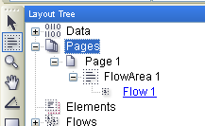
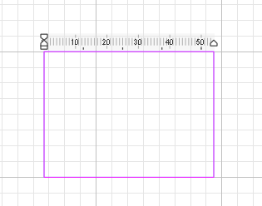
Flow Area
Flow areas define the positions and sizes of text flows.
The flow area tool creates this field for information on the page.
Simply select the tool and click-and-drag to draw a box on your virtual page.

Slide 14
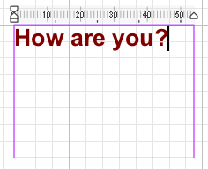
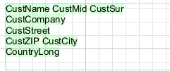
Flow Area
  Flow areas are one of the main objects in a layout.
Within a flow area, fixed or variable information can be displayed:
Text (formatted)‏
Variables (e.g., address fields)‏
Images, bar codes, tables, charts.
Fixed text
Variable text

Slide 15
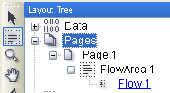
Flow Area
Every time you create a flow area, you also create a flow
  Flow is the content of the flow area
  It is the flow that contains information

Slide 16



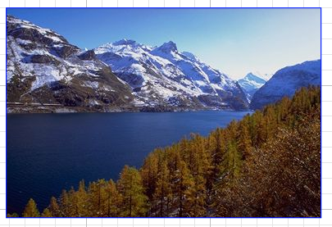
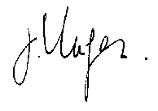
Images
Images (e.g., a logo, signature, etc.) can be inserted into your Layout
and used on your design page as a printable picture.
Images can also be set as a background picture.
Variable images can be defined.
Notes:
Images (e.g., a logo) can be inserted into your Layout and used on your design page as a printable picture.
Images can also be set as a background picture.
(helps to find position for variable fields)‏
Variable images can be defined.
Variable image – an input variable or a script defines the picture which should be printed for each record.

Slide 17
4. Proof

Slide 18
Context Schema
Workflow
Data Input
&
Manipulation
Document
Design
(Layout)‏
Impositioning
Approval (Proof)‏
Spool Production
Notes:
Proof is not a part of the workflow, but it is frequently used during the creation of a workflow.

Slide 19
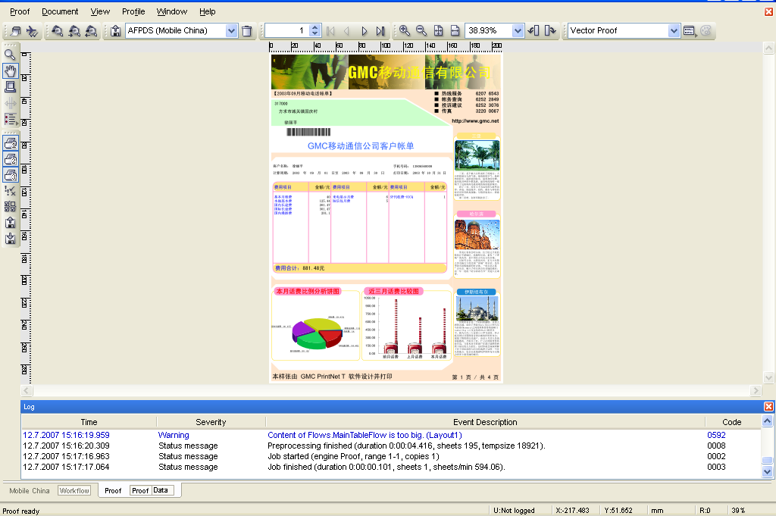
Proof
Output Selection
Print Area Tool
Zoom Tools
Proof Profiles Vector/Raster

Slide 20
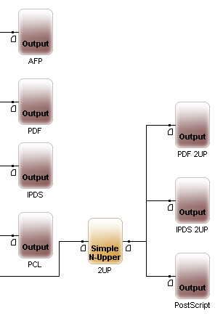
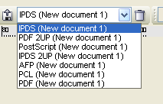
Proof
Multiple Outputs in workflow
Multiple Outputs in proof

Slide 21
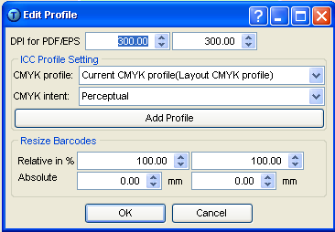
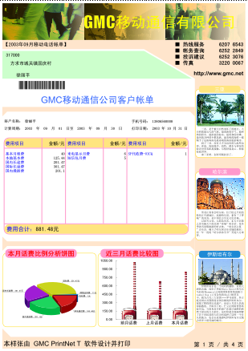
Vector Proofing Profiles
Vector Proof Settings
Proof Results

Slide 22
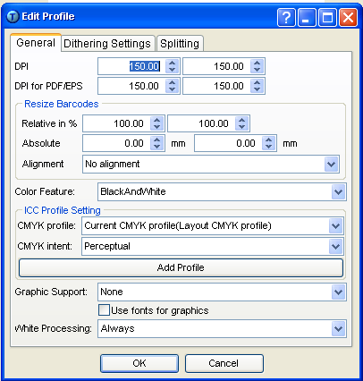
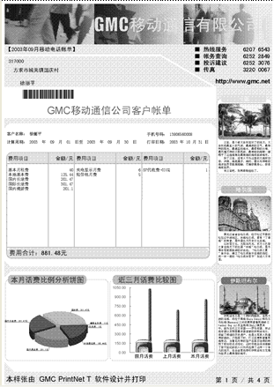
Raster Proofing Profiles
Raster Proof Settings
Proof Results

Slide 23
5. Printing

Slide 24
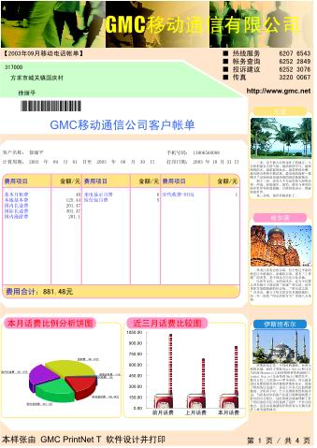
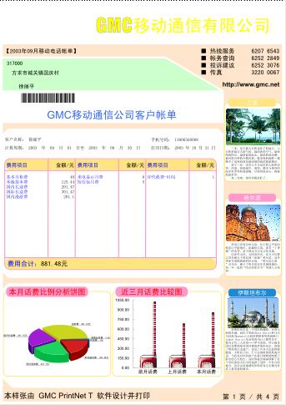
Print Groups
Groups 1, 2, and 3 turned on
Groups 2 and 3 on;
Group 1 turned off
Notes:
With print groups, you can assign images and other objects to specific groups. In proof, you can turn the Print Groups on and off to view your job with and without the Print Groups.
There are three Print Groups.
In this example, the header background image is part of print group 1.

Slide 25
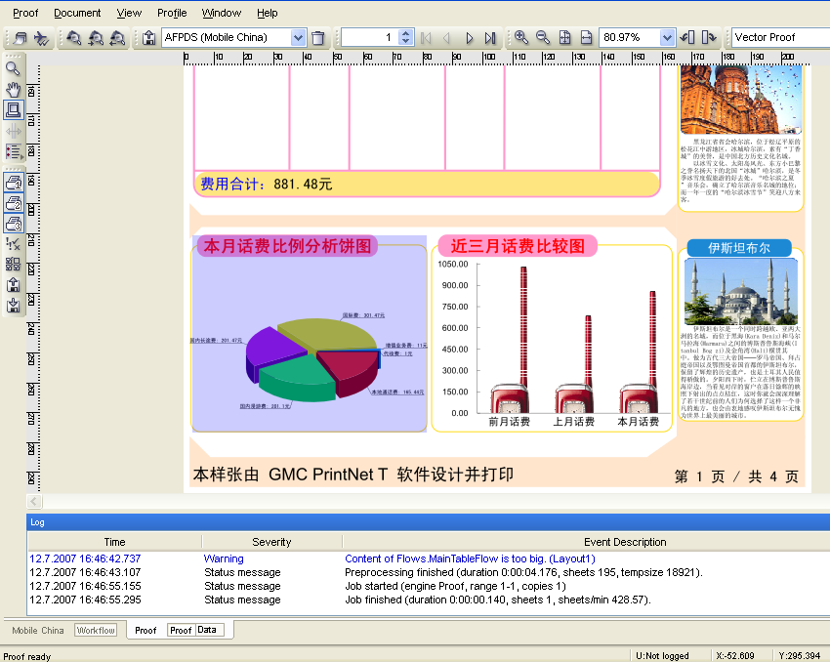
Print Area Tool
Allows us to specify part of the design to be printed

Slide 26
6. Production

Slide 27
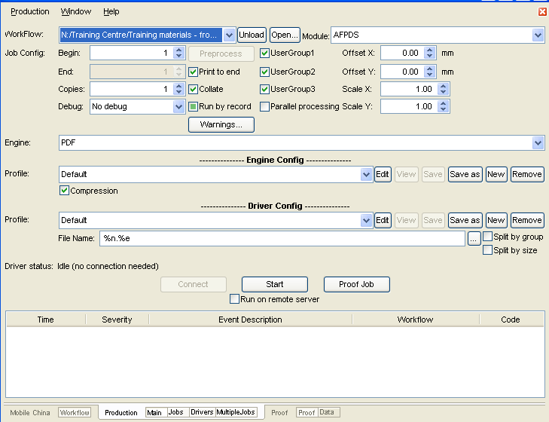
Production Window
Workflow and Modules
Job Configuration
Engine Configuration
Driver Configuration
Production Log Area

Slide 28
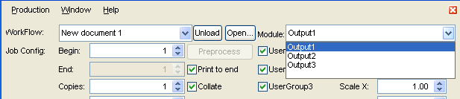
Production Features
Choose different outputs from the same workflow.
Save all settings of the output-module as production configuration.

Slide 29
7. Output

Slide 30
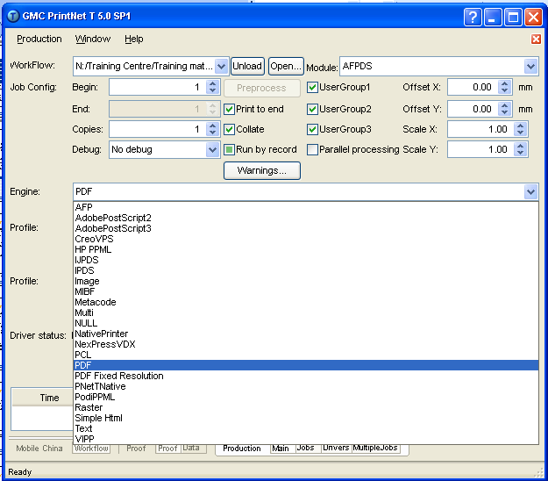
Output Formats
Complete list of output formats.
Change the output without changing the layout.

Slide 31

Thank You.
Do You Have Any Questions?

